Slide 1
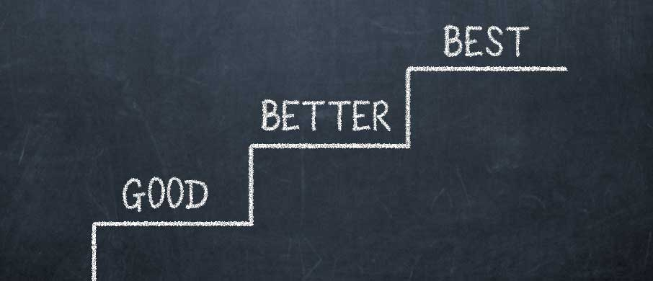
Why Not
Have It All?

Slide 2
Followers of the good
Relational
Godly benefits

Slide 3
I Peter 3:12
For the eyes of the Lord are over the
righteous, and his ears are open unto
their prayers: but the face of the Lord is
against them that do evil.

Slide 4
Followers of the good
Relational
Godly benefits
Human benefits

Slide 5
I Peter 3:13
And who is he that will harm you, if ye be
followers of that which is good?

Slide 6
Followers of the good
Practical
Common sense

Slide 7
I Peter 3:13
And who is he that will harm you, if ye be
followers of that which is good?

Slide 8
Followers of the good
Practical
Common sense
Uncommon issues (struggles)
Happy

Slide 9
I Peter 3:14a
But and if ye suffer for righteousness‘
sake, happy are ye: and be not afraid of
their terror, neither be troubled;

Slide 10
Followers of the good
Practical
Common sense
Uncommon issues (struggles)
Happy
Peaceful

Slide 11
I Peter 3:14b
But and if ye suffer for righteousness‘
sake, happy are ye: and be not afraid of
their terror, neither be troubled;

Slide 12
Followers of the good
Personal
Sanctify yourself to God

Slide 13
I Peter 3:15a
But sanctify the Lord God in your hearts: and be ready always to give an answer to every man that asketh you a reason of the hope that is in you with meekness and fear:

Slide 14
Followers of the good
Personal
Sanctify yourself to God
Prepare to defend

Slide 15
I Peter 3:15b
But sanctify the Lord God in your hearts: and be ready always to give an answer to
every man that asketh you a reason of
the hope that is in you with meekness
and fear:

Slide 16
Followers of the good
Personal
Sanctify yourself to God
Prepare to defend
Answer with hope and a
clear conscience

Slide 17
I Peter 3:16
Having a good conscience; that, whereas
they speak evil of you, as of evildoers,
they may be ashamed that falsely accuse
your good conversation in Christ.

Slide 18
Seeking the better
God’s will

Slide 19
I Peter 3:17
For it is better, if the will of God be so,
that ye suffer for well doing, than for evil
doing.

Slide 20
Proverbs 3:5-6
:5 Trust in the LORD with all thine heart;
and lean not unto thine own
understanding.
:6 In all thy ways acknowledge him, and
he shall direct thy paths.

Slide 21
Seeking the better
God’s will
Our good

Slide 22
I Peter 5:10
But the God of all grace, who hath called
us unto his eternal glory by Christ Jesus,
after that ye have suffered a while, make
you perfect, stablish, strengthen, settle
you.

Slide 23
Romans 5:3-4
:3 And not only so, but we glory in
tribulations also: knowing that tribulation
worketh patience;
:4 And patience, experience; and
experience, hope:

Slide 24
Romans 8:28
And we know that all things work
together for good to them that love God,
to them who are the called according to
his purpose.

Slide 25
Remember the best
All for us

Slide 26
I Peter 3:18
And we know that all things work
together for good to them that love God,
to them who are the called according to
his purpose.

Slide 27
Remember the best
All for us
Is yet to come

Slide 28
Romans 8:18
For I reckon that the sufferings of this
present time are not worthy to be
compared with the glory which shall be
revealed in us.

Slide 29
II Corinthians 4:17-18
:17 For our light affliction, which is but
for a moment, worketh for us a far more
exceeding and eternal weight of glory;
:18 While we look not at the things which
are seen, but at the things which are not
seen: for the things which are seen are
temporal; but the things which are not
seen are eternal.

Slide 30
Keep
Your
Forks

